Slide 1

Next Generation
of Assessment and Accountability

Slide 2
Index Framework

Slide 3
Index 1

Slide 4
Index 2

Slide 5
Index 3

Slide 6
Index 4

Slide 7
Next Steps

Slide 8
5 Domain Framework

Slide 9
Domain 1

Slide 11
Domain 2

Slide 12
Domain 3

Slide 14
Domains 1-5

Slide 15
Small Group Discussion
How can I use this information at my campus/district?
Why is it important?

Slide 16
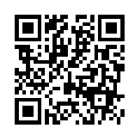
Let’s Speak Up!
Title III Feedback
https://goo.gl/forms/pKsImJcJsbfScDel2

Slide 17
Tickets Out
On a post-it, write a “Tweet” about something you learned today (120 characters or less).
Don’t forget to hash-tag it!

Slide 18
Thank you!
See you February 16th!
Karina E. Chapa, M.Ed.
Language Proficiency, Biliteracy and Cultural Diversity Director
kchapa@esc1.net
Facebook: Region One ESC Bilingual
Twitter @esc1bilingual

